Slide 1

Experiences with the NVIDIA Grace Hopper architecture in HPC systems

Slide 2

CURC Alpine: New User Seminar
Moderators: Andy Monaghan, Craig Earley
Slides: https://github.com/ResearchComputing/rmacc_2024
In the directory “nvidia_GH200_experiences”

Slide 3
Overview
The NVIDIA GH200 Grace Hopper Superchip combines the NVIDIA Grace and Hopper architectures into a single CPU+GPU coherent memory model, with the ability to greatly accelerate data-intensive GPU workflows. This sixty-minute "Birds of a Feather" will enable participants to discuss their early experiences with the GH200, or to learn from others' experiences if they are considering the Grace Hopper architecture.
First 30 minutes – user-facing experiences
Second 30 minutes – system-facing experiences

Slide 4
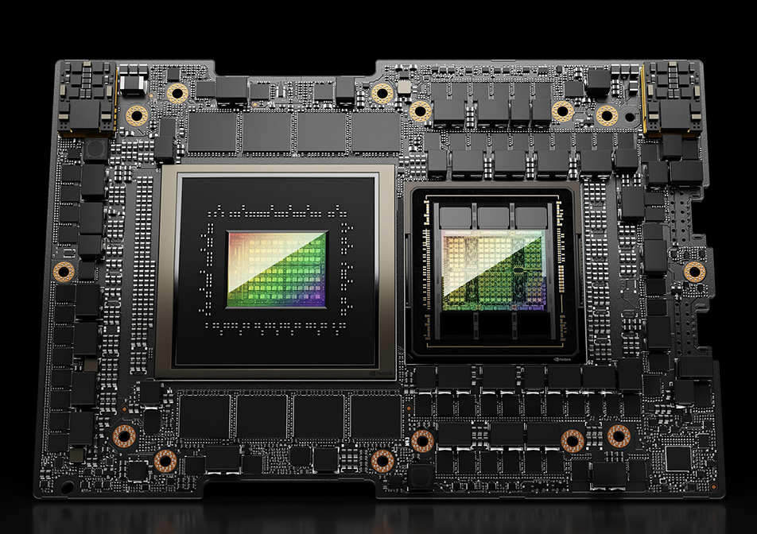
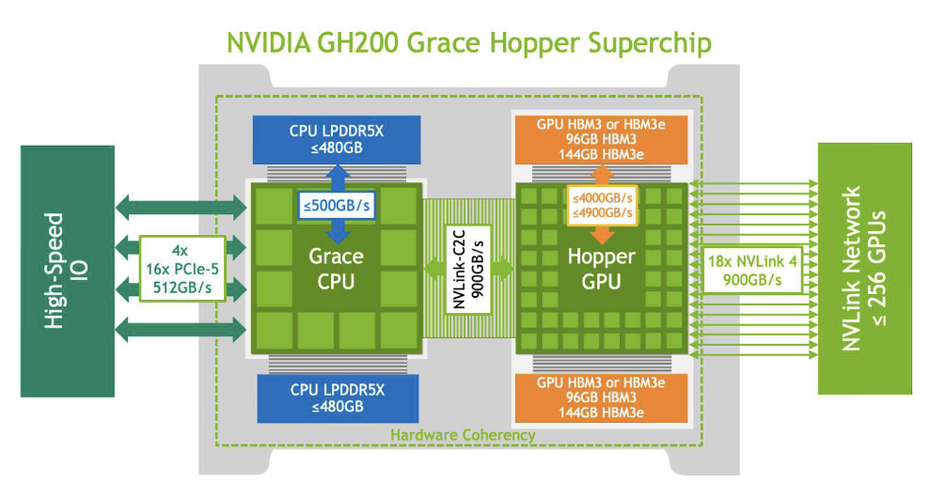
The NVIDIA Grace Hopper 200
Designed for “giant-scale” AI, HPC
Combines Grace CPU w/ Hopper (H100) GPU via 900 GB/s NVLink
3x memory, bandwidth vs stand-alone H100
ARM-based instructions
Multi-instance GPU (MIG) capable
Source for image and specs: https://www.nvidia.com/en-us/data-center/grace-hopper-superchip/

Slide 5
Possible user-facing discussion topics
If you or your users used the GH200 yet, what has the experience been?
What workflows have worked best on the GH200s?
What workflows have not worked well on the GH200s?
What challenges and/or successes have you had with the ARM-based software on the GH200s?
What has been your experience with NVIDIA support?

Slide 6
Possible system-facing discussion topics
What were challenges of deploying the GH200 nodes?
Provisioning challenges?
Data center challenges?
Networking challenges?
How have the nodes performed once deployed?
What has been your experience with NVIDIA support?

Slide 7

Survey and feedback
http://tinyurl.com/curc-survey18

